Slide 1
Truth Misunderstood TODAY
(part 2)
John 9:39-41

Slide 2
Despite That Truth Was Often Misunderstood
We can know the truth (Jn. 8:32; Eph. 5:17; Rom. 12:2)
  If anyone wants to do His will (Jn. 7:17)
  If we follow in fear and humility (Ps. 25:5-12)
  If we treasure truth (Prov. 2:1-6)
  If we are willing to be yoked (Matt. 11:29)
It liberates us from sin and ignorance (Jn. 8:32; Eph. 4:17-21)
Its path can be bright and clear (Prov. 4:18)

Slide 3

Misunderstood Truth Today
NIV translation published on shirts, cards, book markers, etc.
Interpreted as an idea of standing still in trials and the Lord will deliver
Progeny of “faith alone”
Exodus 14:15, 16
“Do not be afraid. Stand still, and see the salvation of the LORD…The LORD will fight for you, and you shall hold your peace” (Ex. 14:13, 14, NKJV)

Slide 4
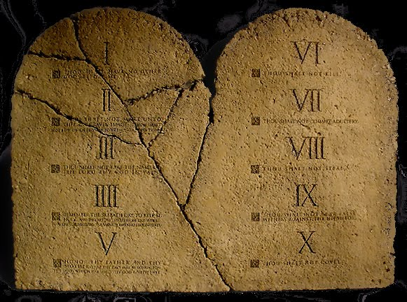
Misunderstood Truth Today
TEN
COMMANDMENTS
“Do not think that I came to destroy the Law or the Prophets. I did not come to destroy but to fulfill. For assuredly, I say to you, till heaven and earth pass away, one jot or one tittle will by no means pass from the law…” (Matt. 5:17, 18)
Interpreted as:
  Jesus did not abolish the least of the commandments—Ten Commandments must be in force
  Sabbath will not pass until heaven and earth pass

Slide 5
Conclusions Which Most Sabbath-Keepers Will Not Accept
TEN
COMMANDMENTS
If Jesus did not abolish the law, then the “jot and tittle” remain along with the Sabbath
  Death penalty for Sabbath breakers
  Every single sacrifice, feast day, and commandment of Moses remains
The “jot and tittle” remain wherever the Sabbath remains
  Agricultural and clothing laws (Lev. 19:19)
  Dietary rules (Lev. 11:6-8)
  Laws of uncleanness and circumcision (Lev. 12:2-5)
  Sacrifices for uncleanness (Lev. 12:6)

Slide 6
“…till all is fulfilled” (Matt. 5:18)
Changes the meaning of the entire verse when left out
When fulfilled even the “jot and tittle” will pass from the law
If the “jot and tittle” pass, then so does the Sabbath command!
If circumcision has passed, then the whole law has passed (Gal. 5:1-7, 11; 6:12, 13, 15

Slide 7
Misunderstood Truth Today
LOVE
“Owe no one anything except to love one another, for he who loves another has fulfilled the law” (Rom. 13:8)
Interpreted as:
  “God’s love is unconditional and unlimited”
  “God’s only law—LOVE!”
  “ If you have LOVE, you have EVERYTHING! You are fulfilling ALL the laws of God!”

Slide 8
Misunderstood Truth Today
LOVE
“Owe no one anything except to love one another, for he who loves another has fulfilled the law” (Rom. 13:8)
Yet…
  Love would prohibit lawlessness: adultery, murder, theft, false witness, covetousness (13:9, 10)
  Love would cast off works of darkness and walk properly (13:11-14)
  Love obeys Christ’s commandments (Jn. 14:15, 21, 23, 24; 15:9-14)

Slide 9
Is Gods’ Love Perfected In You?
Not through inconsistency but through obedience (Jn. 2:3-6; cf. Lk. 6:46)
    3 Now by this we know that we know Him, if we keep His commandments.
    4 He who says, "I know Him," and does not keep His commandments, is a liar, and the truth is not in him.
    5 But whoever keeps His word, truly the love of God is perfected in him. By this we know that we are in Him.
    6 He who says he abides in Him ought himself also to walk just as He walked.

Slide 10
Have You
Repented of your sins (Acts 17:30)?
Confessed that Jesus is the Son of God (Acts 8:37)?
Been baptized into Christ (Gal. 3:27)?
Been striving to live faithfully to His name (Rev. 2:10)?
  Not a false professor
  Not a double tongued person
  Psalm 1:6; 2 Timothy 2:19

